Slide 1




PAGE
Hosting Chatbot on an EC2 instance
Notes:
‹#›

Slide 2
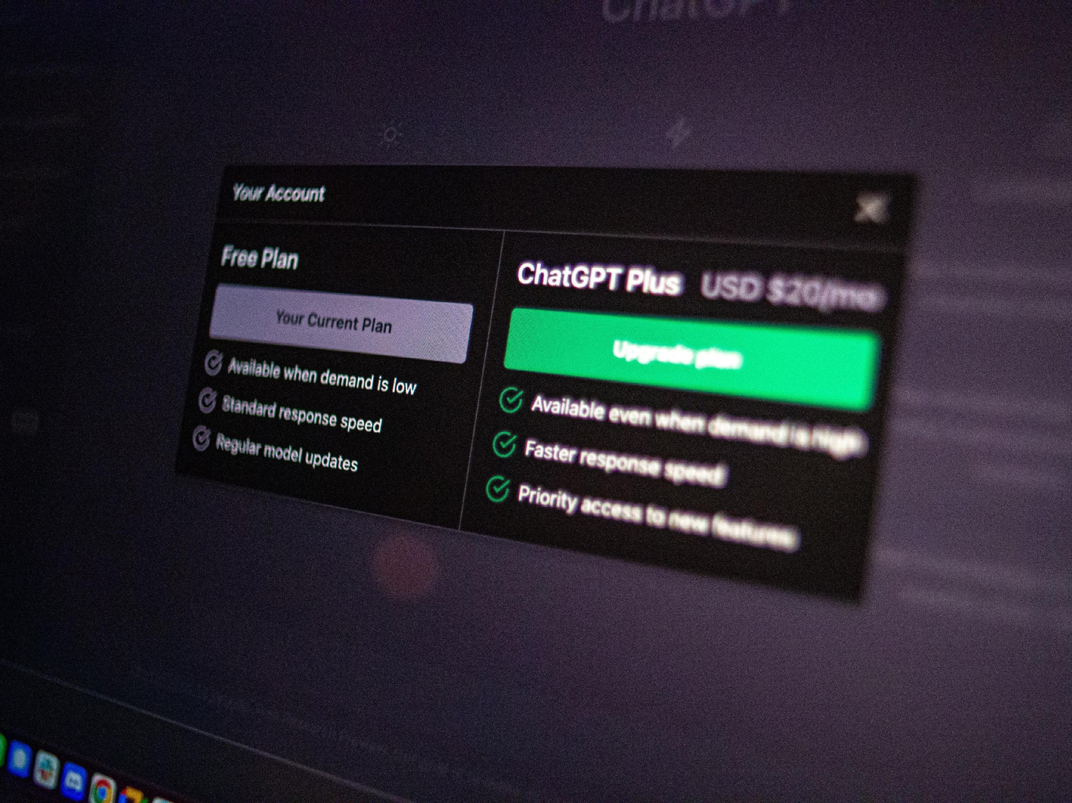
Index
PAGE
Introduction
Chatroom Application
Working of the Chatroom Application
Amazon EC2
Hosting of our Project
Unveiling Our Chatbot

Slide 3



Introduction
In today's digital world, a lot of information is frequently found in PDF documents, making it difficult for users to effectively extract insights. Our research provides a web-based chat application that aims to solve this issue by enabling smooth interaction with PDFs. Our application enables users to ask questions, upload PDF files, and get real-time conversational responses. Utilising new technologies like vector embeddings, text extraction, and similarity search, our platform improves PDF content's usability and accessibility. This project demonstrates the development process, key features, and overall objective of providing customers with an easy-to-use platform for natural language interaction-based insight extraction from PDF documents.
PAGE

Slide 4
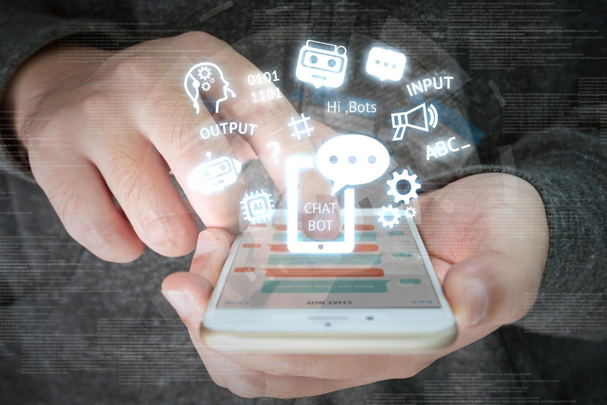
Chatbot Application
Chatbots are AI-powered virtual assistants you can chat with! Imagine a conversation window where you ask questions and get answers. Langchain, a developer toolkit, simplifies building these chatbots. Here's the magic:
You Ask a Question: You type your question in the chat window.
Langchain Captures Input: Langchain receives your question and acts as a bridge.
Connects to Powerful AI: Langchain connects to a large language model (like me!) that can understand your question.
AI Analyzes and Responds: The AI analyzes your question and generates a response.
Langchain Delivers Answer: Langchain delivers the AI's answer back to you in the chat.
Langchain streamlines building chatbots, letting you focus on the conversation design, while the AI handles the complex understanding and response generation.

Slide 5
Working of the Chatbot
Upload PDFs and Extract Text: You upload PDFs, and the code extracts all text content.
Split Text into Chunks: The text is split into smaller manageable pieces.
Create a Search Index: The code creates a searchable index using a powerful AI model (FAISS) for efficient searching.
User Asks a Question: You type your question about the PDFs.
Search for Relevant Parts: The system searches the index using your question to find related parts of the PDFs.
Answer the Question: A large language model, like Bard, analyzes the retrieved parts and answers your question in detail, referencing the PDFs.
PAGE

Slide 6
Amazo﻿n EC2
Amazon EC2, or Elastic Compute Cloud, is a service by Amazon Web Services (AWS) that lets you rent virtual machines (instances). These virtual computers, called instances, can be booted up with various configurations of processing power, memory, storage, and operating system. This allows you to quickly set up and scale compute capacity for your applications without having to manage physical hardware.
Here are some of the reasons why you might use EC2 in your presentation:
Scalability: Easily add or remove computing power as needed.
Cost-effective: Pay only for what you use.
Variety of options: Choose from a wide range of instance types to meet your specific needs.
Fast setup: Get virtual servers up and running in minutes.
EC2 is a popular choice for businesses of all sizes looking for a flexible and cost-effective way to run their applications in the cloud.
PAGE

Slide 7
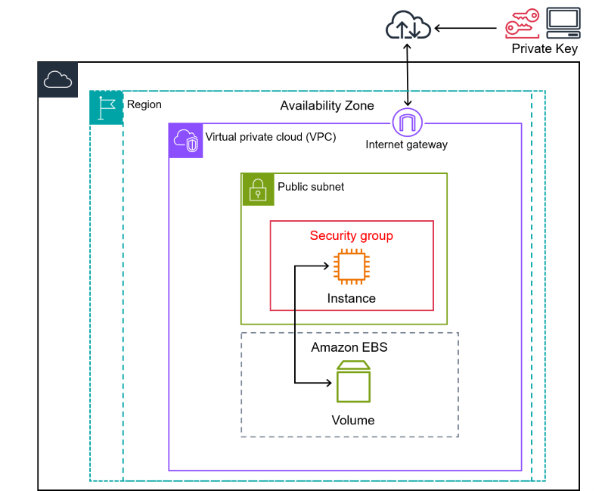
EC2 Basic Architecture

Slide 8
Steps to Deploy our Chatbot on AWS EC2 Instance:
1
2
Create an EC2 instance
Create a virtual environment
PAGE
Creating an EC2 instance on AWS is the first step of deployment in the Cloud. We enter the specifications of the instance and save the .pem (key-pair) file required to access the instance
Using the .pem file and SSH command, we access the EC2 instance and create a virtual environment and eventually install all the required libraries and dependencies.
3
4
Clone the Github Repository
Checking the performance
Now, we create and clone our Git with following commands thus, push our code to Github:
git add {project folder}
git commit -m "model added"
git remote add origin{repo clone link}
git push -u origin master
Finally, we run the Chatroom py file and open the UI. To check whether the working is fine, we upload a simple PDF file and enter related query, to which we get pretty accurate and satisfactory results, meaning success.

Slide 9
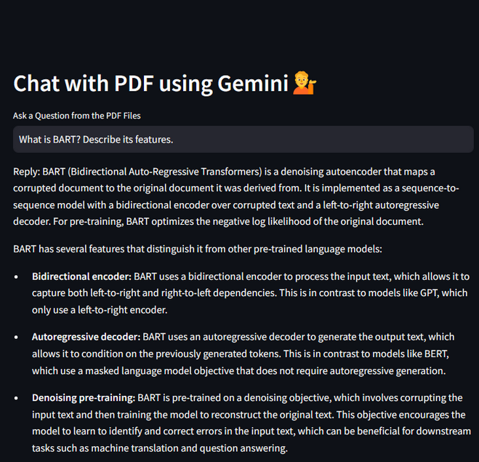
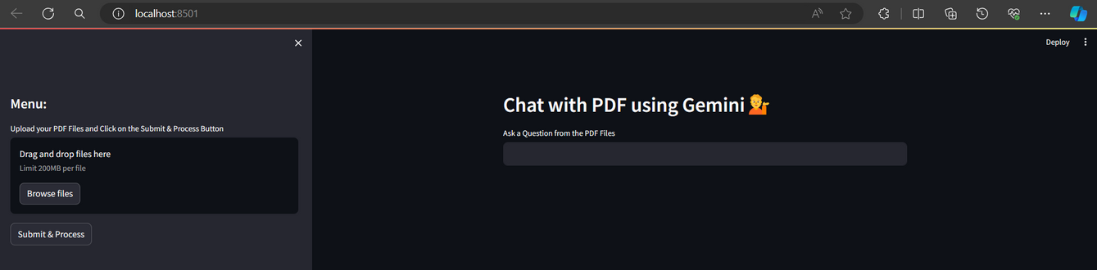
Unveiling our Chatbot

Slide 10
Group Members
PAGE
Devapangu Abhishek (21BDS016)
Hosur Sai Kartik (21BDS021)
Nischay Kondai (21BDS045)
Pratik Raj (21BDS047)

Slide 11
